Slide 1
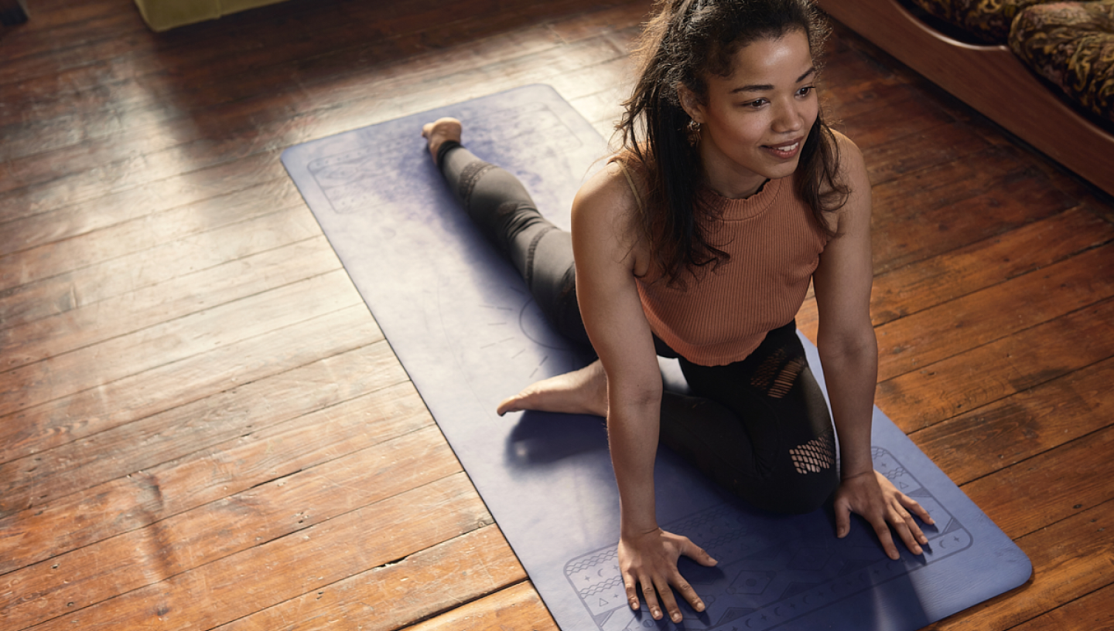




Raising money to sustain your organisation
Buddle.co

Slide 2



Use this doodle box to try the annotation tools whilst you wait.
You can find the annotation tools on the right of your screen
Welcome.
Your session will begin shortly.
Before we start, please ensure that:
If you are using social media, please tag: #Buddle, @SportEngland @SportStructures
Your microphone is muted
You can see and use the chat box
Buddle.co

Slide 3


A little about me…
… and you!
Add Tutor Picture
Add some info about you in the chat box:
- Your Club/Organisation Name
- Where you are based
- What you would like to gain from this workshop?
- Insert name
- Insert Experience
- My favourite …
Buddle.co

Slide 4

Learning Agreement
Respect everybody
Participate actively
Use technology responsibly
Be engaged
Challenge each other positively
Put phones on silent and return calls at an appropriate time
Avoid sharing any personal/sensitive information outside of the session
Buddle.co
Notes:
Please ask learners to consent to the delegate agreement using the chat box/mic etc
Participate actively - contribute to discussions and activities
Use technology responsibly - turning camera on, where possible, to build connections
Be engaged - limit distractions and maintain focus during the session

Slide 5
What we’ll cover:
By the end of this workshop, you will be able to:
Have an overview of different ways to raise money.
Work through the ‘dos and don'ts’ of grant funding including what to include in applications.
Identify where to look for grant funding.
Buddle.co

Slide 6
Eligibility for Funding = Good Governance
Check the criteria of the Tier 1 ‘Code For Sports Governance’. Check your ‘security of tenure’
Structure
People
Communication
Standards and conduct
Policies and processes
How is your organisation doing in these areas?
Buddle.co

Slide 7
Eligibility for Funding = Good Governance – ‘House in order’
Check the criteria of the Tier 1 ‘Code For Sports Governance’. Check your ‘security of tenure’
Structure – constituted, clear purpose. A body that meets and records decisions.
People – Diverse viewpoints considered. Decision makers have skills and diversity to operate effectively.
Communication – shares info on governance, finance, activities and structure so stakeholders understand the position
Standards and conduct-Conflicts of interest are recognised, managed by the chair and recorded. At least three of the people on the governing committee are neither related to, nor cohabiting with, other committee members.
Policies and processes - financial procedures and practices are in place. Risks and liabilities are appropriately assessed.
Buddle.co

Slide 8
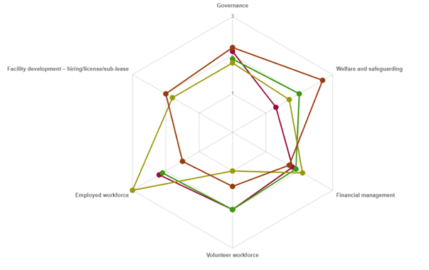


Health Check Tool
A self-assessment tool. Assesses strengths and development areas with signposting to appropriate resources.
Governance
Facility development
Welfare and safeguarding
Employed workforce
Financial management
Volunteer workforce
Buddle.co

Slide 9



How can single site organisations generate additional income?

Slide 10
Raising money to sustain your organisation
Buddle.co

Slide 11
Different ways to generate income
CORE
Membership
Sessions fees
Events
Facility hire/let
Diversifying the use of your facilities
Café (if applicable and manageable)
Vending Machines
ADDITIONAL
Crowd funding
Merchandise
Grant funding (start up or new activity)
Gift Aid
Commissioning
Partnerships
Additional income streams from members/users
Fundraisers
Buddle.co

Slide 12
What is grant funding?
Usually targeted at a specific cause / group
Can be large or small
Usually split into revenue and capital
Buddle.co

Slide 13
Grant funding... Ways to approach it
Make it someone’s responsibility
Involve others e.g. NGB / Active Partnership / LA’s
Harness your expertise
It’s worth the effort
Buddle.co

Slide 14
Grant funding: The “Don’ts”
Expect to receive the funding
Rush it
Go “nuclear”
Just start writing
Use jargon or acronyms
Submit the application without checking it
Leave it until the last minute!
Buddle.co

Slide 15
Grant funding: The “Dos”
Research the funder
Check the criteria(!)
Check how your application will be assessed
Read through the application form first
Plan your project
Build your case
Have a plan to evaluate
Buddle.co

Slide 16
Some things to think about!
Be more than just sport & physical activity
Be different
What is your superpower?
Buddle.co

Slide 17
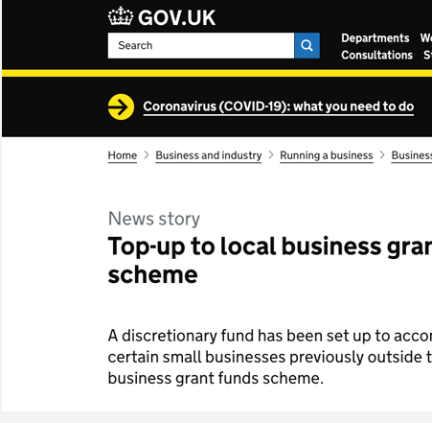


Grant funding:
Where to look…

Slide 18
Where can I find grants?
Local funders
National funders
Trusts and Foundations
Buddle.co

Slide 19
National Funders
Lottery e.g Sport England
Corporates
Central Government
Charities, Trusts and Foundations
Buddle.co

Slide 20

National Lottery Awards for All
Demonstrate how you connect with community
Demonstrate the need for your project
Yes – coaching, volunteer training, service alterations, minor facility alterations, equipment
Buddle.com

Slide 21
Movement fund - £300-£15k
Want to support projects in IMD 1-3
Demonstrate how you connect with community
Demonstrate the need for your project
Yes – coaching, volunteer training, service alterations, minor facility alterations, equipment
Answer what SE are asking for?
Buddle.com

Slide 22
Swimming Pool Support Fund - £63m
To support Swimming Pools
Administered by Sport England – developing criteria and application process
£20m for revenue grants to support increased cost pressures
£43m for capital investment to improve energy efficiency
CLUK are engaged in discussions
Buddle.co

Slide 23
Local Funders
Local Authority
Voluntary Sector Organisation
Active Partnership
Local charities & trusts
Buddle.co

Slide 24
Other ways to generate income?
Notes:
5 mins
Objective – to get organisation to start to think and share ideas on different ways to generate income
Tutor to ask delegates to think of as many ways they can think of that organisations can generate income.

Slide 25
Sponsorship… or is it really partnerships?
Sponsors are looking for return on their investment
Sponsors might be more willing to offer value in kind than cash
Partners want a transactional relationship with your organisation
Understand the 2-way relationship such as:
Volunteers
Catering
Discounts
Kit &
Equipment
Joint fundraising
Manage the relationship carefully with agreements in writing and good communication
Buddle.co

Slide 26
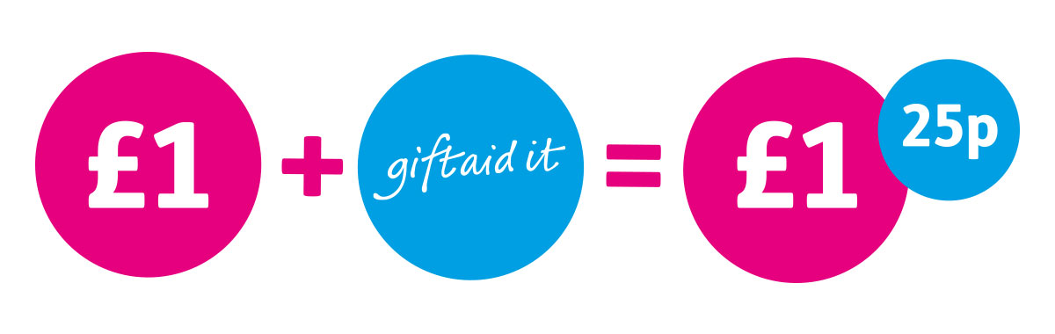
Gift Aid - https://www.gov.uk/claim-gift-aid
As a charity, you can claim 25p for every £1 someone donates.
There are rules on which donations you can claim Gift Aid on.
You can claim for Gift Aid online – usually paid withing 5 weeks.
You need a Gift Aid Declaration from the donor.
Buddle.co

Slide 27
Crowdfunding - https://www.sportengland.org/funds-and-campaigns/our-funds/active-together
Up to £10,000 of match funding.
Help organisations set up Crowdfunding campaigns to help with energy costs, cost of living or other local crisis like flooding.
A fund about recovery, reinvention and building resilience.
In addition to match funding, Sport England are supporting with:
  free 1-2-1 coaching by experts.
  advice and guidance on campaign improvements.
  access to free online courses.
  free 30-minute webinars, monthly.
A lot more benefits than the money – increased membership, sponsorship from local businesses, a greater sense of place in the community as well as new skills like social media, marketing and comms
Buddle.co
Buddle.co

Slide 28
Crowdfunding – Some relevant examples
Kidsgrove Sport Centre Community Group - https://www.crowdfunder.co.uk/p/kidsgrove
Faversham Pools locker project - https://www.crowdfunder.co.uk/p/locker-rewards
Grove Vale Primary School Swimming Pool - https://www.crowdfunder.co.uk/p/save-our-swimming
Frome Community Bike Project - https://www.crowdfunder.co.uk/p/fcbp
Buddle.co

Slide 29
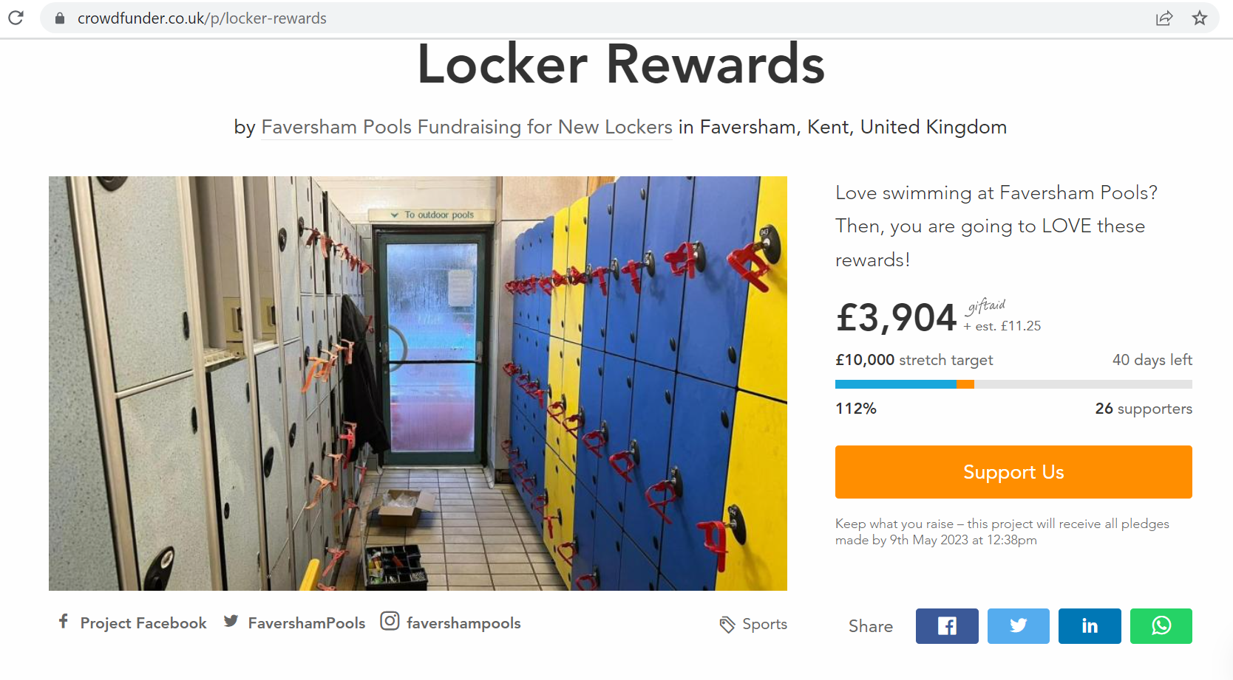
Buddle.co

Slide 30
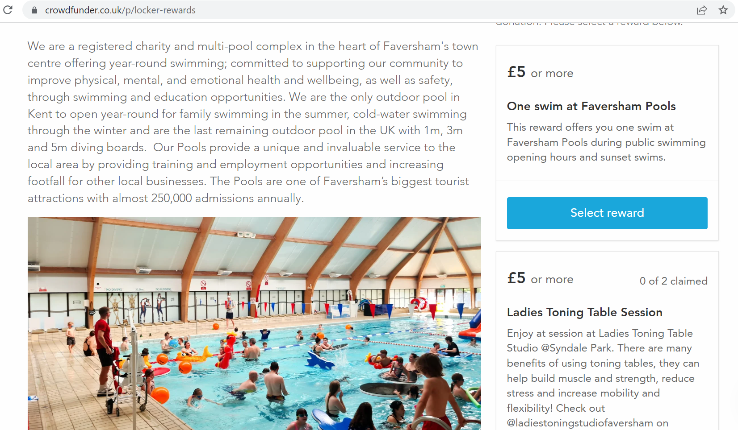
Buddle.co

Slide 31
Crowdfunding – What to do next?
Sign up to one of Sport England’s Crowdfunder webinars to find out more. They run one every month with examples from organisations who have successfully used Crowdfunder
Wednesday April 19th 12-1pm – Sign up here https://www.eventbrite.co.uk/e/crowdfunder-sports-introduction-to-crowdfunding-tickets-526446444487?aff=SEEmail
Thursday May 18th 12-1pm – sign up here https://www.eventbrite.co.uk/e/crowdfunder-sports-introduction-to-crowdfunding-tickets-526447577877?aff=SEEmail
Buddle.co

Slide 32


Reflection
What will you take away from this session?
Any questions?
Please complete the evaluation
Good luck!
Buddle.co

Slide 33
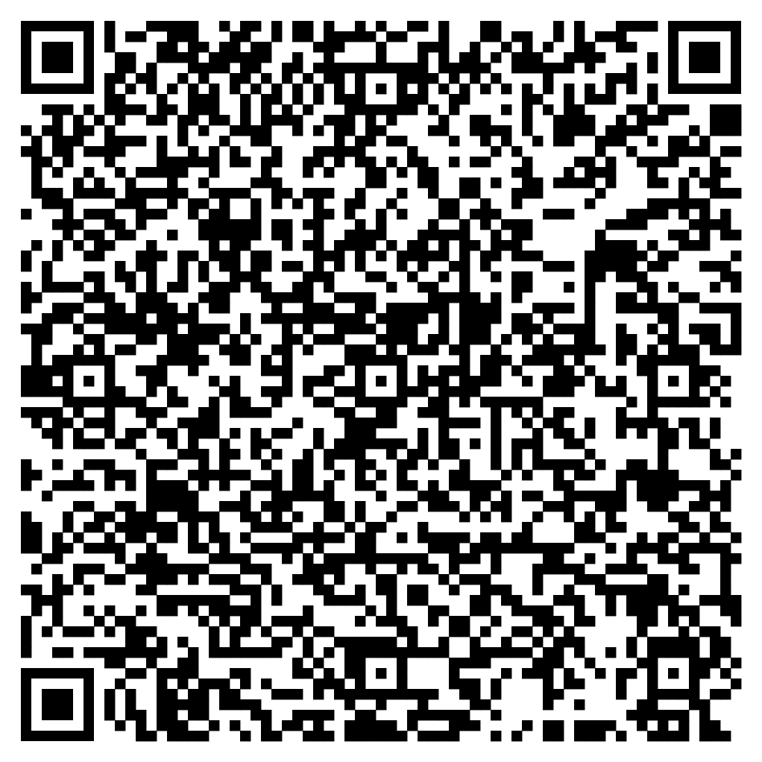





Feedback
Please take the time to fill in the evaluation survey by scanning the QR code.
Alternatively, the tutor will put the link in the chat box for you.
- Thanks in advance, the Buddle Team.

Slide 34
Recap:
By the end of this workshop, you will be able to:
Have an overview of different ways to raise money.
Work through the ‘dos and don'ts’ of grant funding.
Identify where to look for grant funding.
Buddle.co

Slide 35

Buddle training
Getting Organised | Inclusion | Getting Help From People | Money Matters | Develop and Grow
Leadership and Your People | Your Culture and Values In Your Organisation | Maximising Your Volunteers Experience | Raising Money to Sustain Your Organisation | Promoting Your Offer Using Social Media
Exploring Legal Structures | Engaging different People |  | Financial Management | Creating a Marketing Strategy
Simply Planning | Positive Experiences For All People |  | Dealing With Increasing Costs | Engaging your community
See future dates at www.Buddle.co

Slide 36
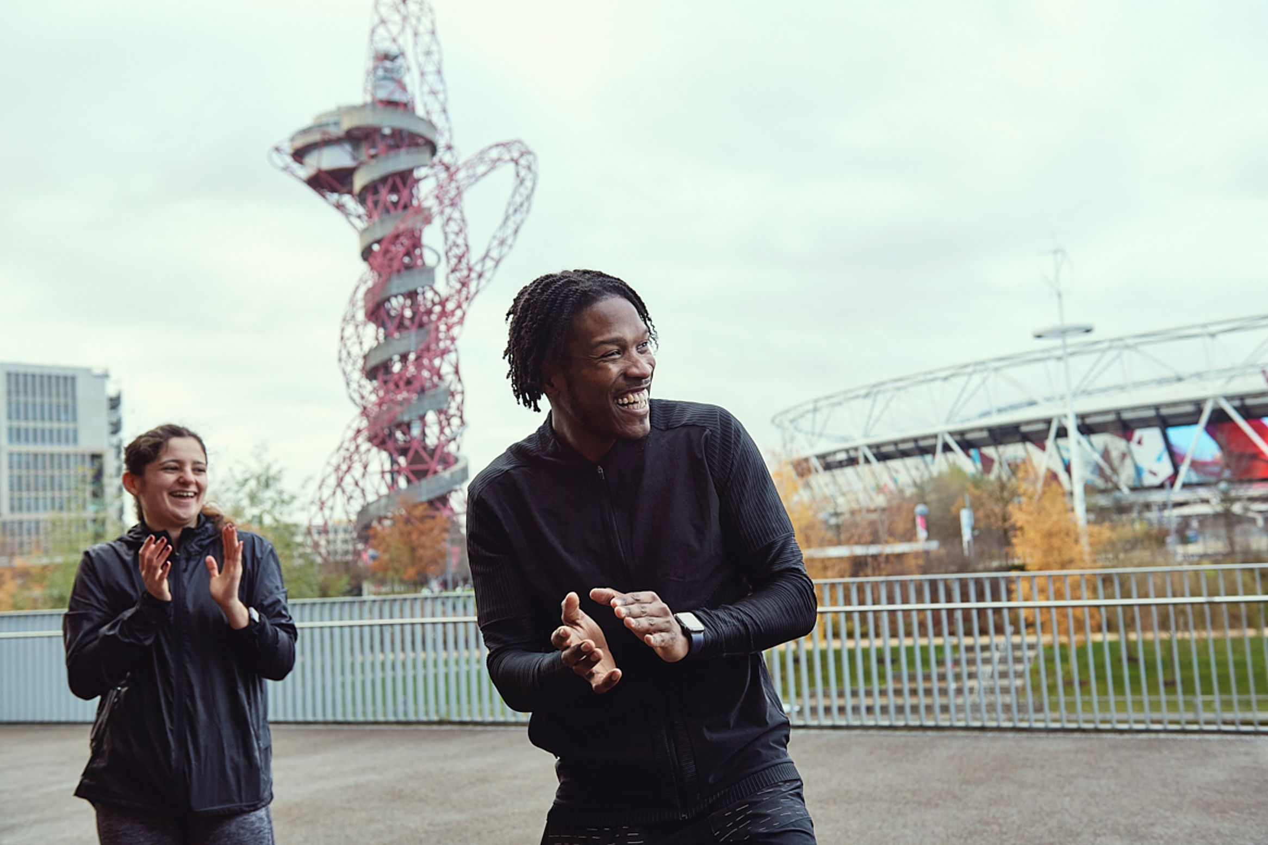
Thank you!
Buddle.co
Notes:
Title box: Click and drag the title box to resize, to allow for longer headings, or to fit around important areas of the image.
Image: To change the image, Right click / Control click on the image, select ‘Change picture… from file’.
Changing colours: Select the colour border area and apply a new shape fill from the Sport England Theme colours (please do not use the tints). Use the same colour for the border and the main title of the presentation.
Changing colours: Right click / control click the background, Select ‘Format background…’ Select a different fill colour from the Sport England Theme colours (please do not use the tints). Use the same colour for the border and the main title of the presentation.

