Slide 1
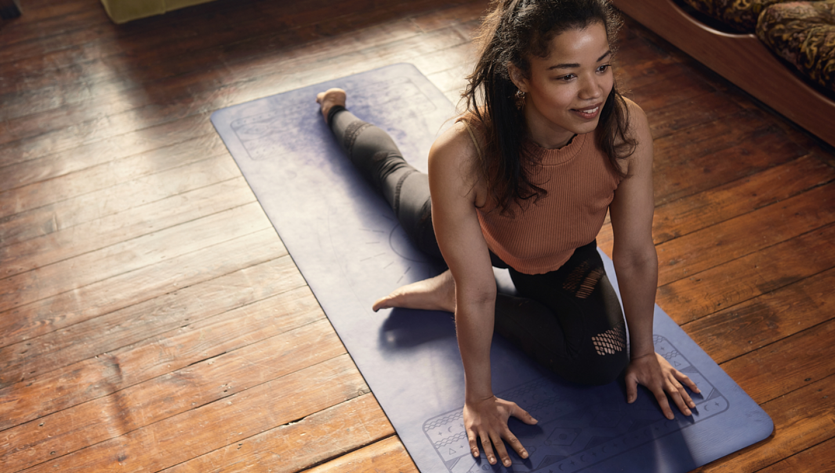




Leadership and Governance
Buddle.co

Slide 2



Use this doodle box to try the annotation tools whilst you wait.
You can find the annotation tools on the right of your screen
Welcome.
Your session will begin shortly.
Before we start, please ensure that:
If you are using social media, please tag: #Buddle, @SportEngland @SportStructures
Your microphone is muted
You can see and use the chat box
Buddle.co

Slide 3


A little about me…
… and you!
Add Tutor Picture
Add some info about you in the chat box:
- Your Club/Organisation Name
- Where you are based
- What would you like to gain from this workshop?
- Insert name
- Insert Experience
- My favourite …
Buddle.co

Slide 4

Learning Agreement
Respect everybody
Participate actively
Use technology responsibly
Be engaged
Challenge each other positively
Put phones on silent and return calls at an appropriate time
Avoid sharing any personal/sensitive information outside of the session
Buddle.co
Notes:
Please ask learners to consent to the delegate agreement using the chat box/mic etc
Participate actively - contribute to discussions and activities
Use technology responsibly - turning camera on, where possible, to build connections
Be engaged - limit distractions and maintain focus during the session

Slide 5
What we’ll cover:
By the end of this workshop, you will be able to:
Review the governance arrangements in your organisation
Review the leadership and management structure
Identify methods on how to achieve an effective committee to lead the organisation
Develop an action plan to improve the organisation leadership and management
Buddle.co

Slide 6
Governance
What do we mean?
Why does it matter?
Buddle.co

Slide 7
A code for governance for sport and community organisations-tier 1
Structure
People
Communication
Standards and conduct
Policies and processes
Buddle.co

Slide 8
A code for governance for sport and community organisations
Structure – constituted, clear purpose. A body that meets and records decisions.
People – Diverse viewpoints considered. Decision makers have skills and diversity to operate effectively.
Communication – shares info on governance, finance, activities and structure so stakeholders understand the position
Standards and conduct - Conflicts of interest are recognised, managed by the chair and recorded. At least three of the people on the governing committee are neither related to, nor cohabiting with, other committee members.
Policies and processes - appropriate financial procedures and practices are in place. Risks and liabilities are appropriately assessed.
Buddle.co

Slide 9
https://www.youtube.com/watch?v=3RmKW87_KAo
Buddle.co

Slide 10
Your Current Structure
?
?
?
?
?
Buddle.co

Slide 11
Current Structure
Is your organisation’s structure effective?
Are decisions made by your main committee?
Do you have individuals carrying out multiple roles?
Do you have a good balance of skills and experience on the committee?
Does each role/responsibility on the Committee and associated sub-committees have a clear role description that outlines their agreed terms of reference?
Buddle.co

Slide 12
Your support?
The right governance can enable your organisation to achieve its vision, aims and objectives
Are you asking the right questions?
Is your organisation reaching into IMD 1-3 or reaching participants from these areas?
Where is most of your support ?
How do you prioritise your current support
Buddle.co

Slide 13
Organisational growth growth / size
Cash reserves
Asset owning
Employing staff
Triggers for change
Power invested in individuals
Contracts
Buddle.co

Slide 14
Current organisational structure?
Management committee
Executive
Board
Leadership team
Other
Trustees
Buddle.co

Slide 15
Reasons to review your structure
Overload and under load
Overlaps cause confusion and conflict
Confused reporting lines
Uncertainty about responsibilities
Long-term poor performance
New priorities and demands
The structure is blocking your strategy
Alan Lawrie (2000)
Buddle.co

Slide 16
Why?
Committee roles are found to be the hardest roles to fill
Recruitment is often reactive to membership growth or external pressures such as new legislation
75% of organisations feel they do not have enough volunteers to meet current operational demands
  Reasons for volunteers considering withdrawing time:
  Lack of time
  Work commitments
  Family Commitments
Sport England: Volunteering Report (2018)
Buddle.co

Slide 17
Consider
Leadership team
Project team
Sub committee
Volunteers
Buddle.co

Slide 18

Strategy before Structure
Buddle.co

Slide 19
A simple framework
Form i.e. the structure should follow function i.e. what you what to be as an organisation.
In its simplest form, there are four major areas of focus to consider when developing a business plan:
An appraisal of your organisation, internal and environment analysis
1
Where are we now?
2
Where do we want to be?
A vision of the future; your organsiations objectives
How do we want to get there?
A framework for action
3
How do we know we are there?
Mechanisms for monitoring
4
Buddle.co

Slide 20
Poll – was your organisation structures put together deliver your strategy/business plan
Yes
No
Don’t Know
Buddle.co

Slide 21
The Board’s key tasks
To provide visionary leadership for development
To develop a strategy for achieving aims.
To ensure the strategy is implemented.
To provide continuity of management.
To promote activity to the community
The Board actively leads its people and its future
Buddle.co

Slide 22
Key roles of the board?
Buddle.co

Slide 23
Key roles of the board are to:
Agree Purpose, Strategy and policies
Establish and uphold the organisations values
Provide representation
Ensure the organisations viability
Ensure accountability of the organisation
Ensure governance is well managed
Resolve conflicting interests between different stakeholders
Set risk policy and take legal responsibility for the organisation
(Mike Hudson 2011)
Buddle.co

Slide 24
Consider:
Span of Control
How many people, activities and types of work can one role supervise effectively?
Authority and responsibility
How should power and decision making be allocated?
What checks and balances need to be built in?
What is the right size leadership team for your organisation to make effective decisions?
Buddle.co

Slide 25
How diverse is your leadership team?
25%
Companies in the top 25% for gender or racial and ethnic diversity are more likely to have higher than average financial returns. Mckinsey
95% of respondents agreed that their boards need to seek more candidates with diverse skills and perspectives – Deloitte
50% of surveyed organisations lack a process for recruiting candidates with diverse skill sets or new perspectives – Deloitte
Where do you gain your board members from?
95%
50%
Buddle.co

Slide 26
Identifying key people
In identifying your key tasks how does your current leadership team match up to those needs
Within or outside of the organisation
Where could you recruit from;
  Membership
  Local business
  Sponsors
  Local volunteer centre
  Sports partnerships
Buddle.co

Slide 27
Local community organisation
Pyrford community centre has about 250 regular members participating in a variety of activities indoor and outdoor and a small surplus in the bank. It provides space for yoga, community events and some outdoor events including a local run on a Saturday and a cycling Sunday session.
A retired couple organise the activities and the facility on a voluntary basis and also do the administration for the organisation
The organisation owns its own building. All fees paid go towards general improvements of the building and buying equipment and paying activity or coaching fees.
The organisation owns a bar that does a roaring trade both from the members and wider village community. Members of the public enjoy taking advantage of the favourable prices. The bar is run by volunteer's mid-week and paid staff at the weekends.
How can you use the governance code to help this organisation to continue to thrive?
Buddle.co

Slide 28
https://www.youtube.com/watch?v=KCzaALVOBwc
Buddle.co

Slide 29




Traditional structures
All Elected by the AGM
People elected are good “doers” and popular in the organisation
Elected for short period
No assessment of ability to carry out the role
Buddle.co

Slide 30
Action planning
What have your learnt from today's session
What could your organisation do to improve its leadership?
What are you going to do to change your leadership team?
When are you going to do this by?
Buddle.co

Slide 31


Reflection
What will you take away from this session?
Any questions?
Please complete the evaluation
Good luck!
Buddle.co

Slide 32
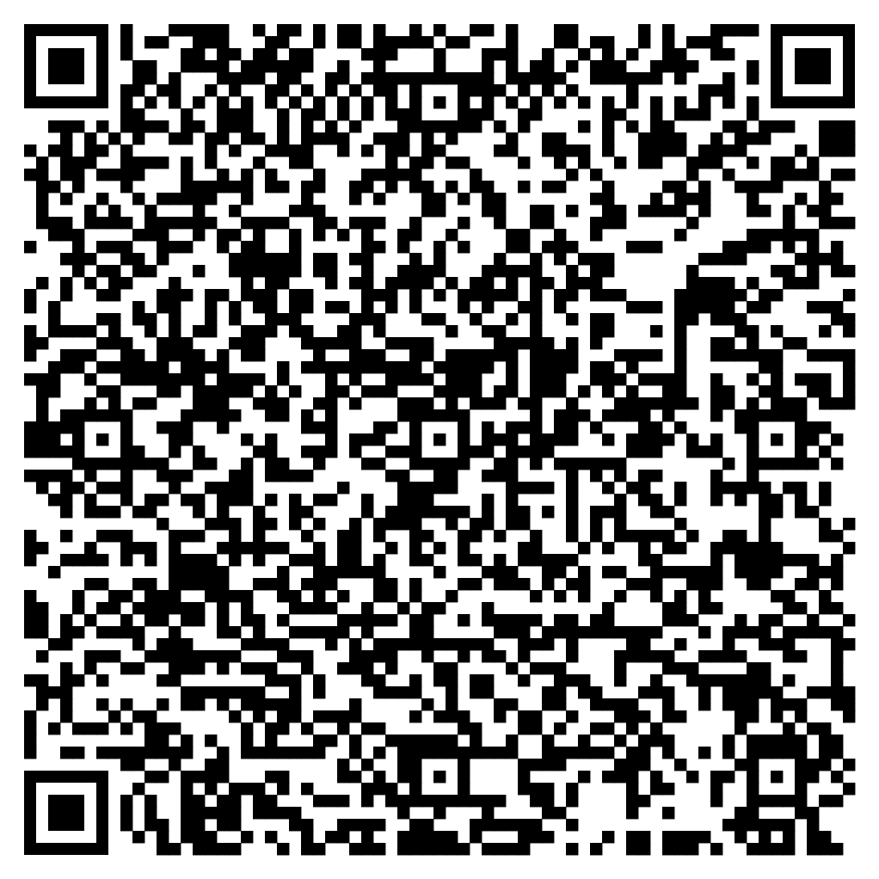





Feedback
Please take the time to fill in the evaluation survey by scanning the QR code.
Alternatively, the tutor will put the link in the chat box for you.
- Thanks in advance, the Buddle Team.

Slide 33
Recap:
By the end of this workshop, you will be able to:
Review the governance arrangements in your organisation
Review the leadership and management structure
Identify methods on how to achieve an effective committee to lead the organisation
Develop an action plan to improve the organisation leadership and management
Buddle.co

Slide 34

Buddle training
Getting Organised | Inclusion | Getting Help From People | Money Matters | Develop and Grow
Leadership and Your People | Your Culture and Values In Your Organisation | Maximising Your Volunteers Experience | Raising Money to Sustain Your Organisation | Promoting Your Offer Using Social Media
Exploring Legal Structures | Engaging different People |  | Financial Management | Creating a Marketing Strategy
Simply Planning | Positive Experiences For All People |  | Dealing With Increasing Costs | Engaging your community
See future dates at www.Buddle.co

Slide 35


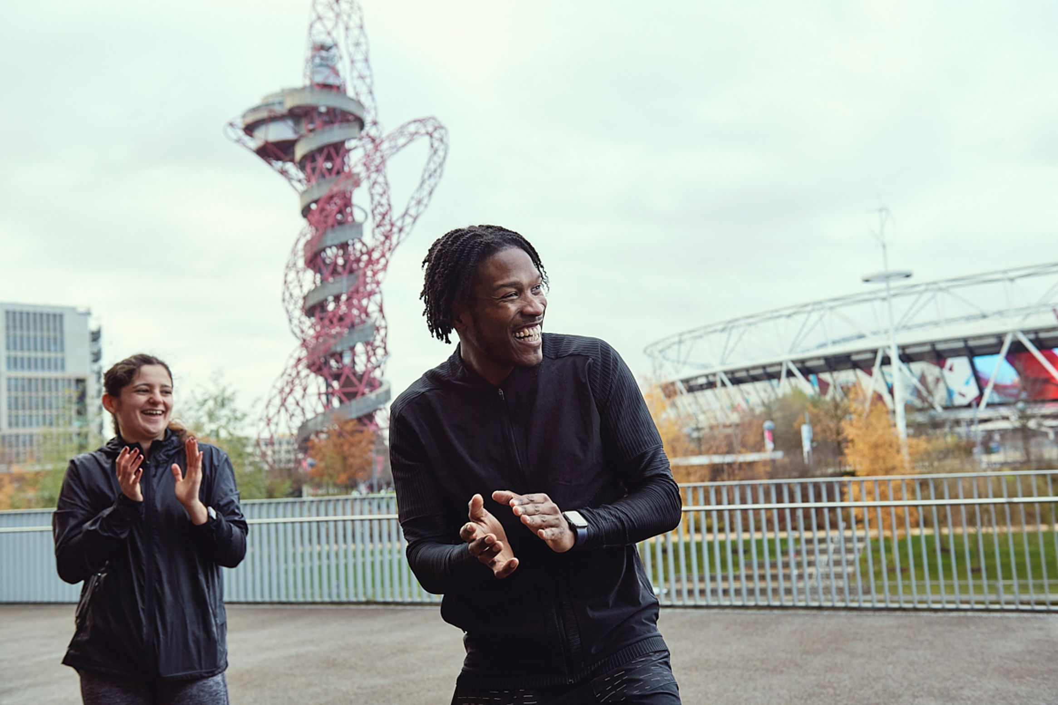
Thank you!
Buddle.co
Notes:
Title box: Click and drag the title box to resize, to allow for longer headings, or to fit around important areas of the image.
Image: To change the image, Right click / Control click on the image, select ‘Change picture… from file’.
Changing colours: Select the colour border area and apply a new shape fill from the Sport England Theme colours (please do not use the tints). Use the same colour for the border and the main title of the presentation.
Changing colours: Right click / control click the background, Select ‘Format background…’ Select a different fill colour from the Sport England Theme colours (please do not use the tints). Use the same colour for the border and the main title of the presentation.

