Slide 1





Exploring Legal Structures
Buddle.co
Notes:
For Face to Face

Slide 2



Use this doodle box to try the annotation tools whilst you wait.
You can find the annotation tools on the right of your screen
Welcome.
Your session will begin shortly.
Before we start, please ensure that:
If you are using social media, please tag: #Buddle, @SportEngland @SportStructures
Your microphone is muted
You can see and use the chat box
Buddle.co

Slide 3


A little about me…
… and you!
Add Tutor Picture
Add some info about you in the chat box:
- Your Organisation Name
- Where you are based
- What you would like to gain from this workshop?
- Insert name
- Insert Experience
- My favourite …
Buddle.co

Slide 4

Learning Agreement
Respect everybody
Participate actively
Use technology responsibly
Be engaged
Challenge each other positively
Put phones on silent and return calls at an appropriate time
Avoid sharing any personal/sensitive information outside of the session
Buddle.co
Notes:
Please ask learners to consent to the delegate agreement using the chat box/mic etc
Participate actively - contribute to discussions and activities
Use technology responsibly - turning camera on, where possible, to build connections
Be engaged - limit distractions and maintain focus during the session

Slide 5
What we’ll cover:
By the end of this workshop, you will be able to:
Understand the importance of legal structures
Identify the different types of legal structures and which structure is right for your organisation
Identify top tips on how to effectively govern your organisation
Understand next steps through action planning and where to find further help and advice
Buddle.co

Slide 6
Your current structure
  How is your organisation currently structured?
  Why is it structured that way?
  Is this the best structure for you now and in the future?
  Does the structure reflect your vision and objectives?
Buddle.co

Slide 7
What is your current Legal Status?
Are you:
Members only organisation
CASC
Company Limited by Guarantee
Charity
Buddle.co

Slide 8
Form Follows Function
What your organisation is, or what you want it to be (its function), must be established before the form or structure is decided.
The right structure can enable your organisation to achieve its vision, aims and objectives
What is your organisation about?
What does your organisation want to be?
What is your vision and what are the objectives?
What is the structure that is best suited to what you want to be?
Buddle.co

Slide 9
What is it and why does it matter?
Organisation structure = how an organisation is viewed in the eyes of the law
Why is it important to have the right structure?
Best reflects the activities of the organisation.
Protection for those involved
Save money - tax benefits
Promotes good governance
Important to people outside of the organisation
Buddle.co

Slide 10
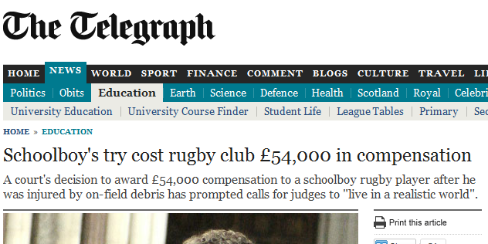
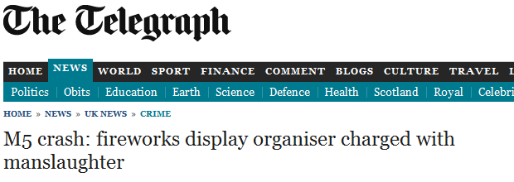
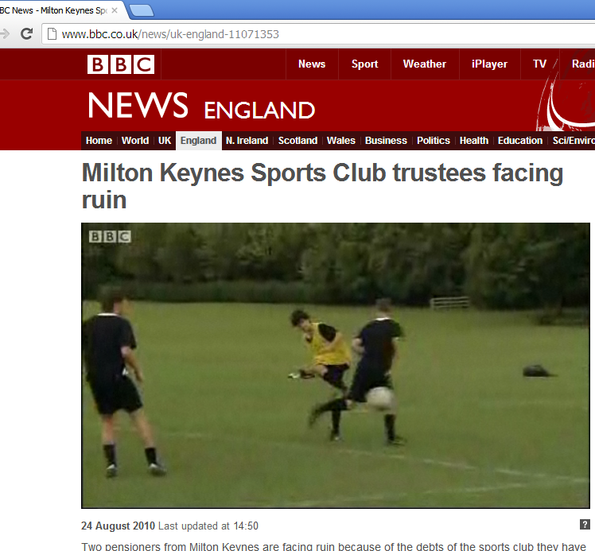
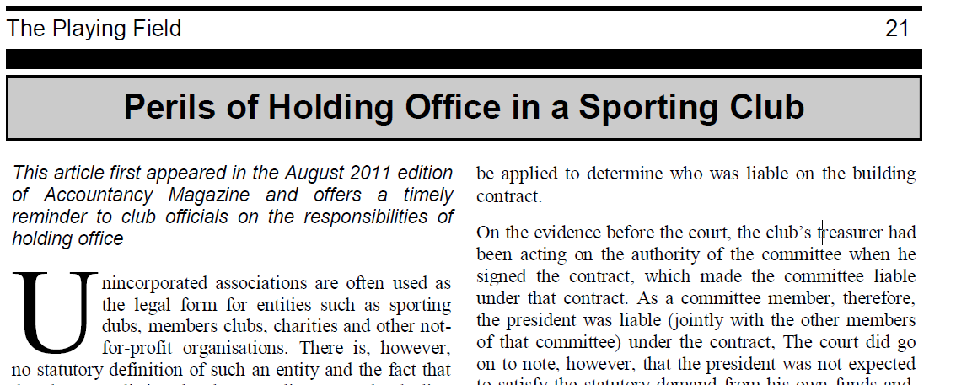
Buddle.co

Slide 11
Membership growth / size
Cash reserves
Employing staff
Triggers for change
Contracts
Power invested in individuals
Asset owning
Buddle.co

Slide 12
Unincorporated vs Incorporated
 | Unincorporated | Incorporated
Separate legal entity?
Contracts?
Limited liability?
Admin requirements?
Governance requirements?
Statutory requirements?
Buddle.co

Slide 13
Unincorporated vs Incorporated
 | Unincorporated | Incorporated
Separate legal entity? | No | Yes
Contracts? | In name of member | In name of organisation
Limited liability? | No | Yes
Admin requirements? | None specifically required | Yes – e.g. companies House/FCA/charity Commission
Governance requirements? | No legal requirements | Legal requirements
Statutory requirements? | Operate within them | Operate within them and any additional
Buddle.co

Slide 14
Benefits and drawbacks
Unincorporated
Incorporated
No formal legal requirements
No extra admin
More formal structure
Promotes good governance
Limited personal liability
Viewed well by external parties
x
x
Not a legal entity
Unlimited liability
Increased personal risk
Formal legal requirements
Admin (e.g. annual return / annual accounts)
Responsibilities of Directors
Buddle.co

Slide 15
Type of Organisational Structure
Unincorporated
Unincorporated association
Incorporated
Company limited by guarantee
Company limited by shares
Community Benefit Society
Charitable Incorporated Organisation
Buddle.co

Slide 16
Unincorporated
Incorporated
Unincorporated association
Company limited by guarantee
Company limited by shares
Community Benefit Society
Charitable Incorporated Organisation
Buddle.co

Slide 17
Unincorporated
Incorporated
Unincorporated association
Company limited by guarantee
Company limited by shares
Community Benefit Society
Charitable Incorporated Organisation
3. No separate legal entity
1. Owned by the members
5. Can be public or private
2. Must be for the benefit of the community
4. Combines charitable status and an incorporated entity in one structure
6. No formal legal requirements
9. Liability limited, often to £1
8. Owned by shareholders
7. Operate on 1 member 1 vote system
10. Individual has unlimited liability
Buddle.co

Slide 18




Where to get support for becoming incorporated
Company limited by guarantee
Community Interest Company
Company limited by shares
www.companieshouse.gov.uk/
https://www.gov.uk/government/organisations/office-of-the-regulator-of-community-interest-companies
Community Benefit Society
Remember to register with HMRC – even if there will be no tax to pay!
http://www.hmrc.gov.uk/ct/getting-started/new-company/start-up.htm
https://www.fca.org.uk/firms/mutual-societies
Charitable Incorporated Organisation
www.charitycommission.gov.uk/
Buddle.co
18

Slide 19
Charity Considerations
Key benefits
  Tax reliefs, including mandatory 80% relief from business rates and special VAT treatment
  Fundraising: grants may be more freely available to charities, and general perception makes a difference to the amount people donate
Possible drawbacks
  Administrative burden
  Requires resource to fundraise
  Cannot pay players or trustees - only reasonable expenses
Buddle.co

Slide 20
CASC Considerations
Key benefits
Business rate relief (Mandatory 80% relief)
The ability to generate income through Gift Aid (individuals and companies)
Exempt from Corporation Tax profits if:
  Trading income < £50k / year
  Rental income < £30k / year
  Exemption from Capital Gains Tax
Possible drawbacks
  May need to change organisation constitution
  Once you’ve gone down this route, you can’t change back
  Form filling in (similar to becoming incorporated)
  Potential significant cost if organisation is deregistered
How significant are these benefits to your organisation?
Buddle.co

Slide 21
Governing Documents
Memorandum of Association
Article of Association
Bye-laws / rules
Constitution
Buddle.co

Slide 22
Andy’s Bowls Club (ABC)
Andy’s Bowls Club (ABC) has about 250 regular members and a small surplus in the bank.
A retired couple both coach the teams in their spare time and on a voluntary basis and also do the administration for the organisation.
The organisation owns its own building. All fees paid go towards general improvements of the organisation and buying equipment and paying referee fees.
The organisation owns a bar that does a roaring trade both from the organisation and wider village community. Members of the public enjoy taking advantage of the favourable prices. The bar is run by volunteer's mid-week and paid staff at the weekends.
How would you structure this organisation, and why?
Buddle.co

Slide 23


Reflection
What will you take away from this session?
Any questions?
Please complete the evaluation
Good luck!
Buddle.co

Slide 24
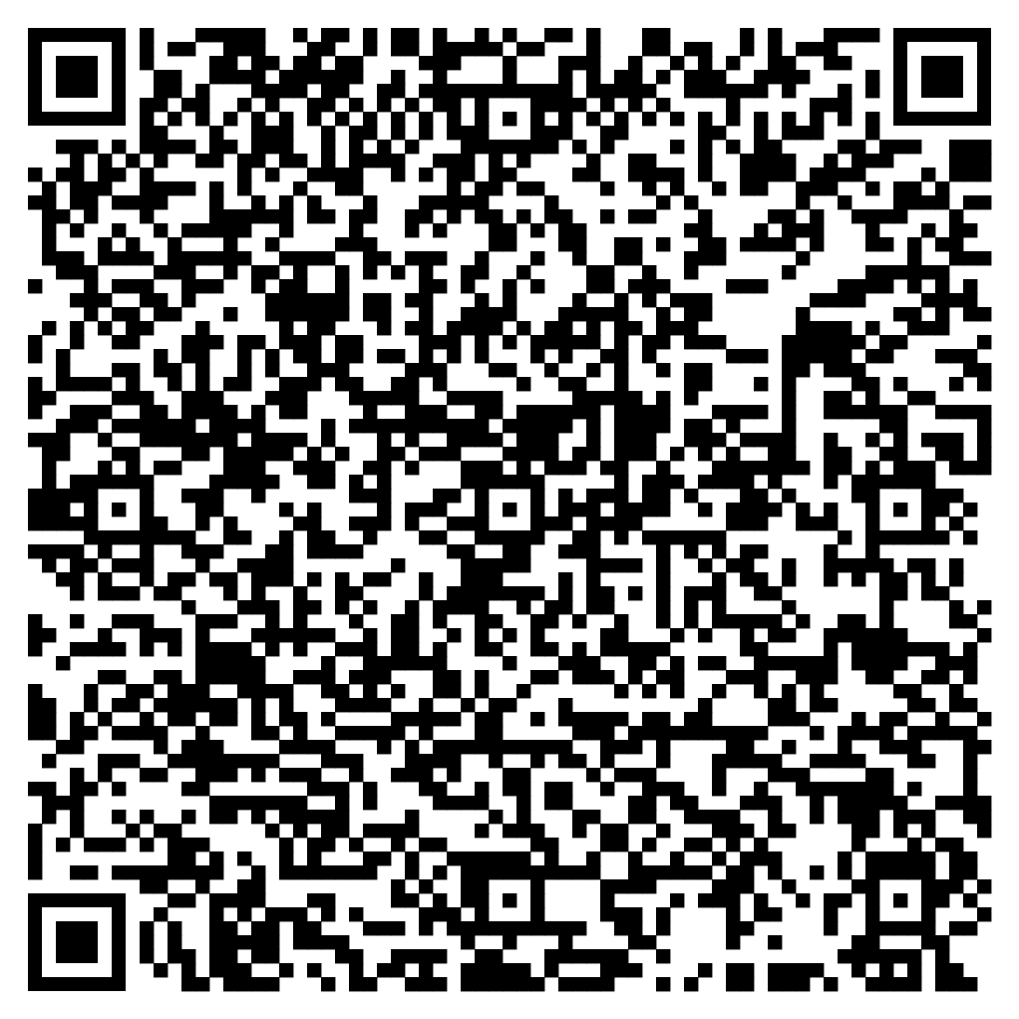





Feedback
Please take the time to fill in the evaluation survey by scanning the QR code.
Alternatively, the tutor will put the link in the chat box for you.
- Thanks in advance, the Buddle Team.

Slide 25
Recap:
By the end of this workshop, you will be able to:
Understand the importance of legal structures
Identify the different types of legal structures and which structure is right for your organisation
Identify top tips on how to effectively govern your organisation
Understand next steps through action planning and where to find further help and advice
Buddle.co
Notes:
Tutor guidance: mandatory slide
Timing: 1 mins
Type of Activity: Presentation
Objective: Tutor to check learning against outcomes
5 mins
OBJECTIVE – Tutor to check that the learning outcomes have been met
Tutor to summarise the workshop and check with attendees if these outcomes have been met. Also considering anything additional was covered or can be signposted.
Tutor to ask them to write down their 3 take aways from the workshop – what are they going to do next.
Tutor to use the next slide to inform of Buddle as a whole for further support. Tutor to also ask delegates to do the evaluation.

Slide 26

Buddle training
Getting Organised | Inclusion | Getting Help From People | Money Matters | Develop and Grow
Leadership and Your People | Your Culture and Values In Your Organisation | Maximising Your Volunteers Experience | Raising Money to Sustain Your Organisation | Promoting Your Offer Using Social Media
Exploring Legal Structures | Engaging different People |  | Financial Management | Creating a Marketing Strategy
Simply Planning | Positive Experiences For All People |  | Dealing With Increasing Costs | Engaging your community
See future dates at www.Buddle.co

Slide 27



Thank you!
Buddle.co
Notes:
Title box: Click and drag the title box to resize, to allow for longer headings, or to fit around important areas of the image.
Image: To change the image, Right click / Control click on the image, select ‘Change picture… from file’.
Changing colours: Select the colour border area and apply a new shape fill from the Sport England Theme colours (please do not use the tints). Use the same colour for the border and the main title of the presentation.
Changing colours: Right click / control click the background, Select ‘Format background…’ Select a different fill colour from the Sport England Theme colours (please do not use the tints). Use the same colour for the border and the main title of the presentation.

